Slide 1

EDA
Team 3
Madhura Jadhav Yuri Oh Ariful Islam Sunil Kumar Akul Jain

Slide 2
1: EDA

Slide 3
Problem Statement
A Bank manager wants to take care of customer retention for its product - Credit Card.
The bank wants the data mining team to identify customers that are at risk of leaving the bank.
Team needs to create an automated ‘customer churn prediction’ process by training, validating and deploying a data mining model
Team has given the sample dataset consisting of 10,115 customers with information such as salary, marital status, credit card limit, credit card category, etc.

Slide 4
Data Summary
1 Target variable:
Attrition Flag with two possible values - Attrited Customer, Existing Customer
19 Predictor variables:
6 categorical variables
13 numerical variables
1 Identifier variable:
CLIENTNUM – indicating client number for the customer
The data is imbalanced as only 16% of the records (1,621) represents ‘Attrited’ customers while 84% (8,494) represents ‘Existing’ ones

Slide 5
Data Preprocessing
Missing Data Imputation: ‘unknown’ values of following categorical variables have been replaced with the mode value for the respective variable : Income Category, Marital Status, Education Level
Reclassifying Categorical Variables: Following categorical variables are ordinal in nature. Therefore, we have transformed them to dummy numerical values to include them in correlation matrix
Income Category | T Income Category
Less than $40K | 1
$40K - $60K | 2
$60K - $80K | 3
$80K - $120K | 4
$120K + | 5
Education Level | T Education Level
Uneducated | 1
High School | 2
College | 3
Graduate | 4
Post Graduate | 5
Doctorate | 6

Slide 6
Variables
Following are the independent variables chosen for EDA by each of the group member
Contacts_Count_12_mon : Madhura Jadhav
Total_Trans_Amt : Madhura Jadhav
Total Revolving Balance : Ariful Islam
Months Inactive 12 mon : Ariful Islam
Total_Trans_Ct : Yuri Oh
Marial Status : Yuri Oh
Credit_Limit : Sunil Kumar
Customer Age : Akul Jain

Slide 7
1: Contacts_Count_12_mon by Madhura Jadhav
Number of contacts with the bank by customer in last 12 months
It’s a discrete numerical variable
Range 6 – 0 = 6
No missing value
Summary Statistics
Total Count | 10115
Min | 0
Max | 6
Mean | 2.455
Median | 2
Mode | 3
Std. Deviation | 1.106

Slide 8
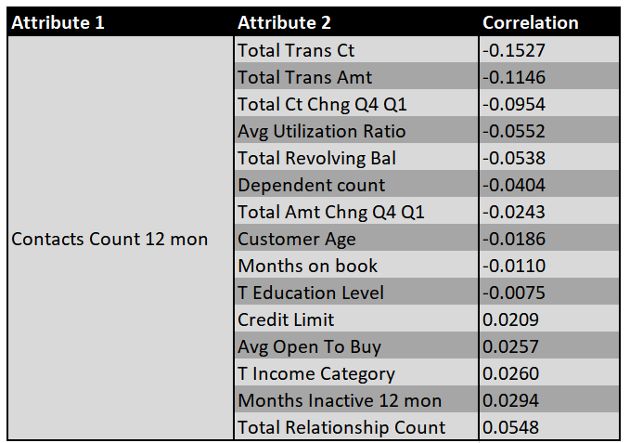
1: Contacts_Count_12_mon by Madhura Jadhav
Association with Other Variables- Correlation

Slide 9
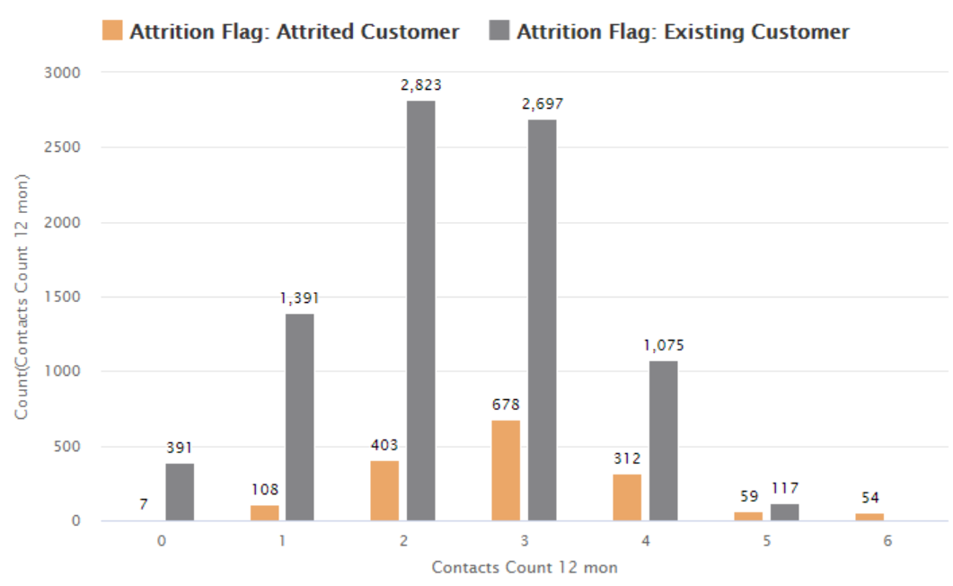
1: Contacts_Count_12_mon by Madhura Jadhav
Association with Target Variable
Contacts count | Attrited | Existing | Total
0 | 0.07% | 3.87% | 3.93%
1 | 1.07% | 13.75% | 14.82%
2 | 3.98% | 27.91% | 31.89%
3 | 6.70% | 26.66% | 33.37%
4 | 3.08% | 10.63% | 13.71%
5 | 0.58% | 1.16% | 1.74%
6 | 0.53% | 0% | 0.53%
Total | 16.03% | 83.97% | 100.00%

Slide 10
1: Contacts_Count_12_mon - Summary by Madhura Jadhav
It is highly likely that if contacts count is more than 5, customer will be attrited.
Most of the attrited customers contacted the bank at least once.
87% of the attrited customers contacted the bank between 2-4 times.
Correlations to all other variable are weak. Therefore, it is an independent variable.

Slide 11
2: Total_Trans_Amt by Madhura Jadhav
Total Transaction Amount by customer in last 12 months
It’s a continuous numerical variable
Range 18,484-510=17,974
No missing value
Summary Statistics
Total Count | 10,115
Min | 510
Max | 18,484
Mean | 4,394.56
Median | 3896
Mode | 4509
Std. Deviation | 3385.52

Slide 12
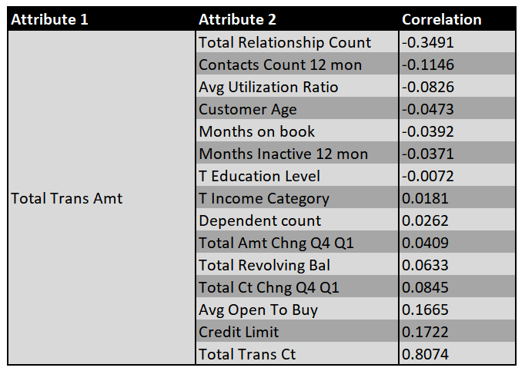
2: Total_Trans_Amt by Madhura Jadhav
Association with Other Variables- Correlation

Slide 13
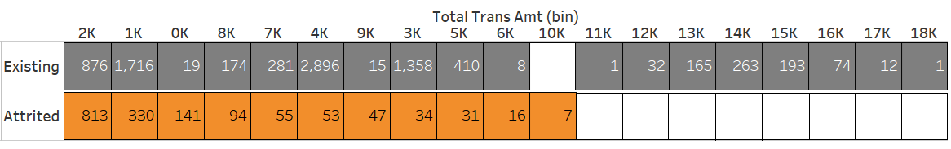
2: Total_Trans_Amt by Madhura Jadhav
Association with Target Variable
Total Trans Amt is binned using equal width method with bin width=1000
Following table is sorted based on Attrited Customer column
0
0
0
0
0
0
0
0
0
1284 i.e. 79.21% of Attrited customers have ‘Total Transaction Amount’ less than 3000

Slide 14
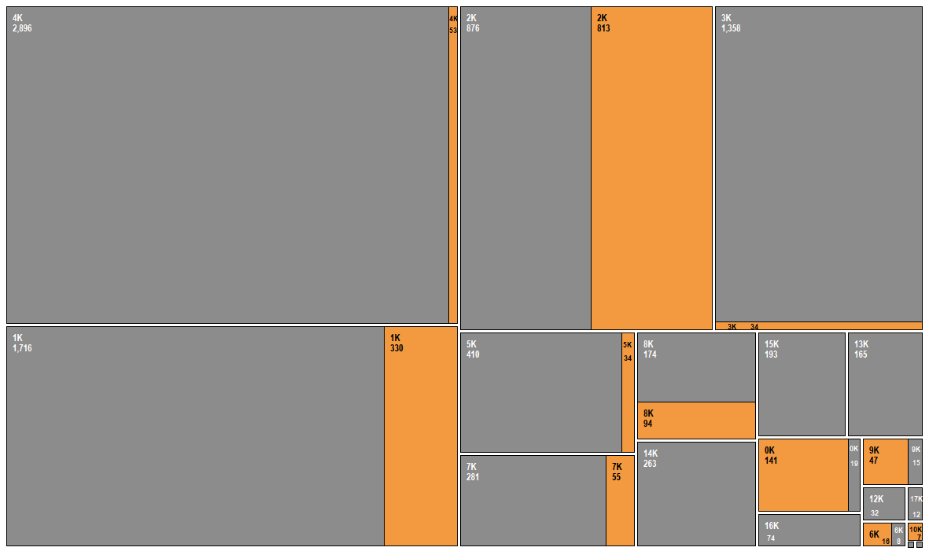
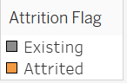
Association with Target Variable

Slide 15
2: Total_Trans_Amt- Summary by Madhura Jadhav
Almost 80% of attrited customers have total transaction amount lesser than 3000
None of the attrited customers have total transaction amount more than 10000
Strong correlation of 0.8074 between ‘Total_Trans_Amt’ and ‘Total_Trans_Ct’ variables. This indicates that these variables are directly proportional. We can skip one of these variables in model building.
‘Total Relationship Count’ variable has a considerable correlation of -0.3491. However, it is not strong enough to skip this variable in model building.
Correlation to all other variables are weak.

Slide 16
3: Total Revolving Balance by Ariful Islam
Total Revolving credit card balance the customer had at the time of attrition.
It’s a discrete numerical variable
Balance Range $0 - $2,517
No Missing Value
Summary Statistics
Total Count | 10115
Min | 0
Max | 2517
Mean | 1162.42
Median | 1276
Mode | 0
Std. Deviation | 814.875

Slide 17
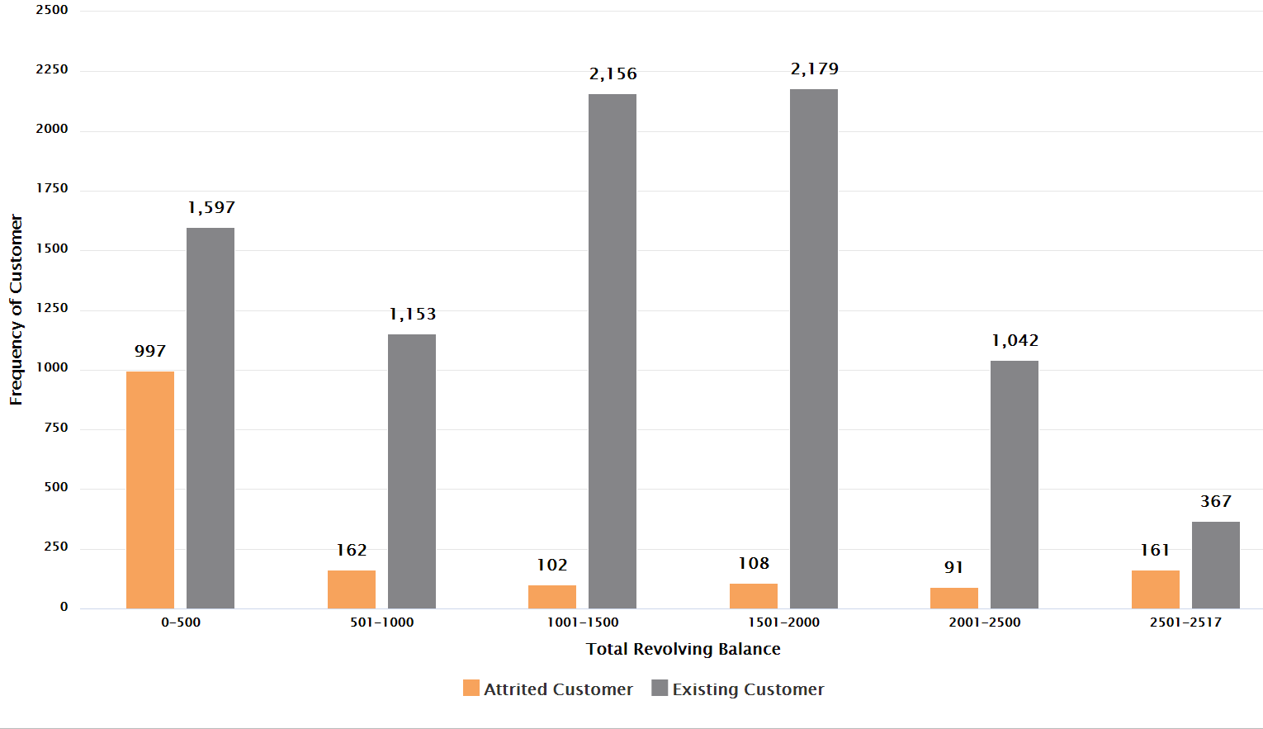
3: Total Revolving Balance by Ariful Islam
 | RBP | Existing Cust. | Existing % | Attrited Cust. | Attrited %
Revolving Balance Position | 0-500 | 1597 | 19% | 997 | 62%
 | 501-1000 | 1153 | 14% | 162 | 10%
 | 1001-1500 | 2156 | 25% | 102 | 6%
 | 1501-2000 | 2179 | 26% | 108 | 7%
 | 2001-2500 | 1042 | 12% | 91 | 6%
 | 2501-2517 | 367 | 4% | 161 | 10%
Total Count | 10115 | 8494 | 100% | 1621 | 100%
Customers are more likely to leave
Existing Customers

Slide 18
3: Total Revolving Balance by Ariful Islam
Attribute 1 | Attribute 2 | Correlation
Total Revolving Balance | Customer Age | 0.014
 | Dependent count | -0.003
 | Months on book | 0.009
 | Total Relationship Count | 0.014
 | Months Inactive 12 mon | -0.042
 | Contacts Count 12 mon | -0.054
 | T Education Level | -0.0097
 | Credit Limit | 0.042
 | T Income Category | 0.033
 | Avg Open To Buy | -0.047
 | Total Amt Chng Q4 Q1 | 0.059
 | Total Trans Amt | 0.063
 | Total Trans Ct | 0.055
 | Total Ct Chng Q4 Q1 | 0.09
 | Avg Utilization Ratio | 0.624
Association with Other Variables- Correlation

Slide 19
3: Total Revolving Balance - Summary by Ariful Islam
It is highly likely that the customers had lower revolving balance are more likely to be attrited.
62% of the total attrited customers had balance between $0-$500.
Correlation with all other variables are weak except Avg. Utilization ratio variable.

Slide 20
4: Months Inactive 12 months by Ariful Islam
Months inactive 12 months is the no. of months inactive in last 12 months.
It has discrete numerical value.
Value range 0-6
No missing value.
Summary Statistics
Total Count | 10115
Min | 0
Max | 6
Mean | 2.341
Median | 2
Mode | 3
Std. Deviation | 1.011

Slide 21
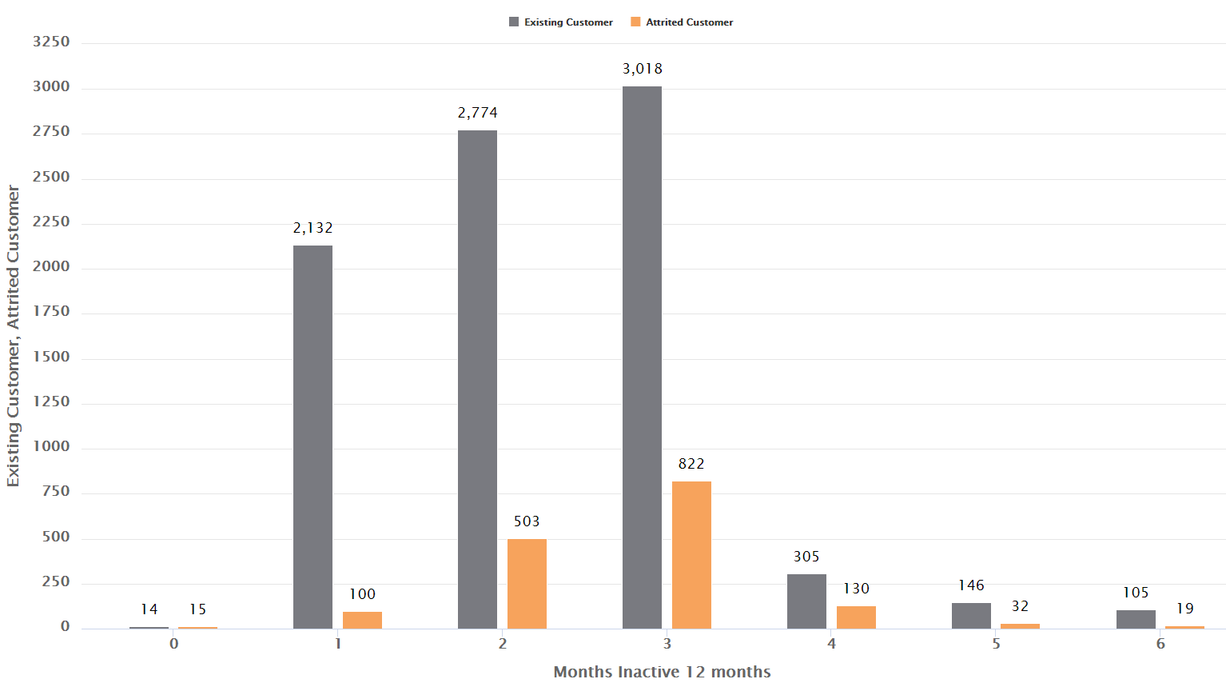
4: Months Inactive 12 months by Ariful Islam
 |  | Existing Cust. | Existing % | Attrited Cust. | Attrited %
Months Inactive 12 months | 0 | 14 | 0.93% | 15 | 0.16%
 | 1 | 2132 | 6.17% | 100 | 25.10%
 | 2 | 2774 | 31.03% | 503 | 32.66%
 | 3 | 3018 | 50.71% | 822 | 35.53%
 | 4 | 305 | 8.02% | 130 | 3.59%
 | 5 | 146 | 1.97% | 32 | 1.72%
 | 6 | 105 | 1.17% | 19 | 1.24%
Total |  | 1621 | 100% | 8494 | 100%

Slide 22
4: Months Inactive 12 months by Ariful Islam
Attribute 1 | Attribute 2 | Correlation
Months Inactive 12 months | Customer Age | 0.055
 | Dependent count | -0.011
 | Months on book | 0.074
 | Total Relationship Count | -0.004
 | Total revolving balance | -0.042
 | Contacts Count 12 mon | 0.029
 | T Education Level | -0.005
 | Credit Limit | -0.021
 | T Income Category | -0.0153
 | Avg Open To Buy | -0.017
 | Total Amt Chng Q4 Q1 | -0.032
 | Total Trans Amt | -0.037
 | Total Trans Ct | -0.043
 | Total Ct Chng Q4 Q1 | -0.039
 | Avg Utilization Ratio | -0.007
Association with Other Variables- Correlation
Correlation with all other variables are weak, therefore it is an independent variable.

Slide 23
4: Months Inactive 12 months - Summary by Ariful Islam
Total of 68.19% out of total attrited customers were inactive between 2-3 months
Data suggests that if the customer is inactive for more then 1 months, there is a high possibility that the customer might be attrited.

Slide 24
5: Total_Trans_Ct by Yuri Oh
Number of transaction with the bank by the customer within the last 12 months
It’s a discrete numerical variable
Range 10-139
No missing value
Summary Statistics
Total Count | 10,115
Min | 10
Max | 139
Mean | 64.832
Median | 67
Mode | 81
Std. Deviation | 23.456

Slide 25
5: Total_Trans_Ct by Yuri Oh
Association with Other Variables- Correlation
Attribute 1 | Attribute 2 | Correlation
Total trans Ct | Total Trans Amt | 0.8074
 | Total Revolving Bal | 0.0554
 | Total Relationship Count | -0.2421
 | Total Ct Chng Q4 Q1 | 0.1118
 | Total Amt Chng Q4 Q1 | 0.0059
 | T Income Category | -0.0555
 | T Education Level | ​-0.0076
 | Months on book | -0.0504
 | Months Inactive 12 mon | -0.0425
 | Dependent count | 0.0503
 | Customer Age | -0.0678
 | Credit Limit | 0.076
 | Contacts Count 12 mon | -0.1527
 | Avg Utilization Ratio | 0.0030
 | Avg Open To Buy | 0.0710

Slide 26
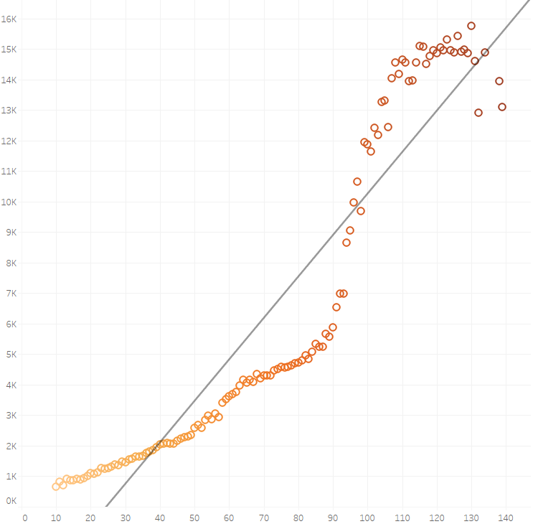
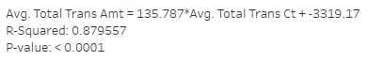
5: Total_Trans_Ct by Yuri Oh
Association with Total_Trans_Amt –
High Correlation

Slide 27
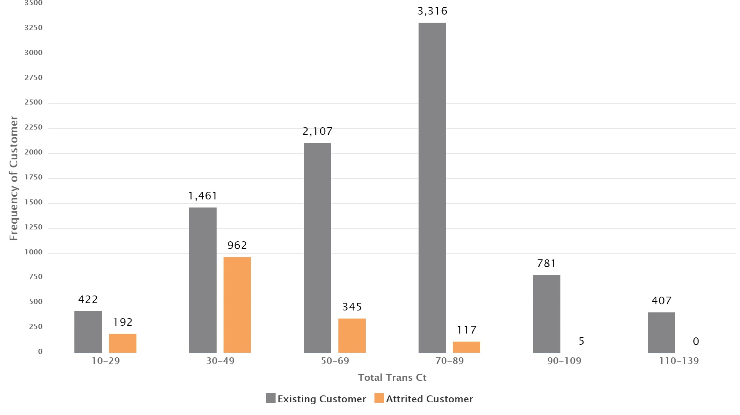
5: Total_Trans_Ct by Yuri Oh
Association with Target Variable
Customers have
more possibilities to leave
Customers have
more possibilities to stay
 | Transaction Count | Existing Cust. | Existing % | Attrited Cust. | Attrited %
Total Transaction Count | 10-29 | 422 | 5% | 192 | 12%
 | 30-49 | 1,461 | 17% | 962 | 59%
 | 50-69 | 2,107 | 25% | 345 | 21%
 | 70-89 | 3,316 | 39% | 117 | 7%
 | 90-109 | 781 | 9% | 5 | 0%
 | 110-139 | 407 | 5% | 0 | 0%
Total Count |  | 8,494 | 100% | 1,621 | 100%

Slide 28
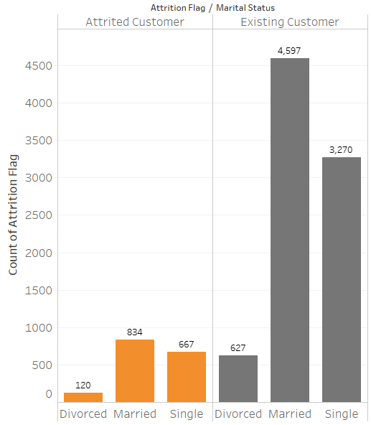
6: Marital_Status by Yuri Oh
‘Unknown’ values of following categorical variables have been replaced with the mode value for the respective variable : Unknown → Married
747 Unknown : 127 Attrited Customer, 620 Existing Customer
Association with Target Variable
Customers have
more possibilities to leave
Marital Status | Existing Cust. | Existing % | Attrited Cust. | Attrited % | Grand Total
Divorced | 627 | 7.38% | 120 | 7.40% | 747
Married | 4,597 | 54.12% | 834 | 51.45% | 5,431
Single | 3,270 | 38.50% | 667 | 41.15% | 3,937
Grand Total | 8,494 | 100% | 1,621 | 100% | 10,115

Slide 29
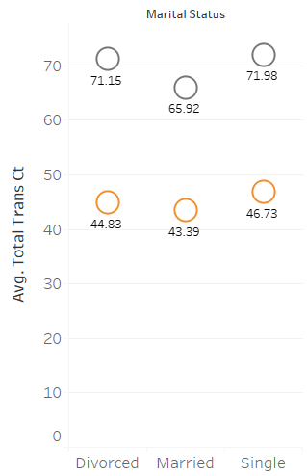
6: Total_Trans_Ct & Marital_Status by Yuri Oh
Married customers have the lowest average total transaction count.
The average total transaction count for all the attrited customers is between 43 and 47.
The average total transaction count for the married attrited customers was 43.39, the lowest among other attrited customers. It shows that married customers are more likely to be attrited.

Slide 30
6: Summary by Yuri Oh
It is highly likely that the customers who had lower transaction count are more likely to be attrited.
Married customers were the highest in numbers for attrition, hence they had the lowest transaction count.
The average total transaction count of the existing customer is 153% higher than the attrited customer.
71% of the total attrited customers had less than 50 transactions with the bank.
Customers who were married had fewer transaction counts than other customers.

Slide 31
7: Credit_Limit by Sunil Kumar
Credit limit is the total credit given by bank on credit card.
It’s a continuous numerical variable
Range 1438.3 – 34516
No missing value
Summary Statistics
Total Count | 10115
Min | 1438.3
Max | 34516
Mean | 8631.482165
Median | 4548
Mode | 34516
Std. Deviation | 9092.689

Slide 32
7: Credit_Limit by Sunil Kumar
Attribute 1​ | Attribute 2​ | Correlation​
​ ​ ​ ​ ​ ​ ​ Credit Limit​ ​ ​ ​ ​ ​ | Customer Age​ | 0.002
 | Dependent count​ | 0.068
 | Months on book​ | 0.007
 | Total Relationship Count​ | -0.072
 | Months Inactive 12 mon​ | -0.021
 | Contacts Count 12 mon​ | 0.021
 | Total trans Ct​ | 0.076
 | Total Revolving Bal​ | 0.042
 | Avg Open To Buy​ | 0.996
 | Total Amt Chng Q4 Q1​ | 0.013​
 | Total Trans Amt​ | 0.172​
 | Total Ct Chng Q4 Q1​ | -0.002
 | Avg Utilization Ratio​ | -0.483​
Association with Other
Variables- Correlation

Slide 33
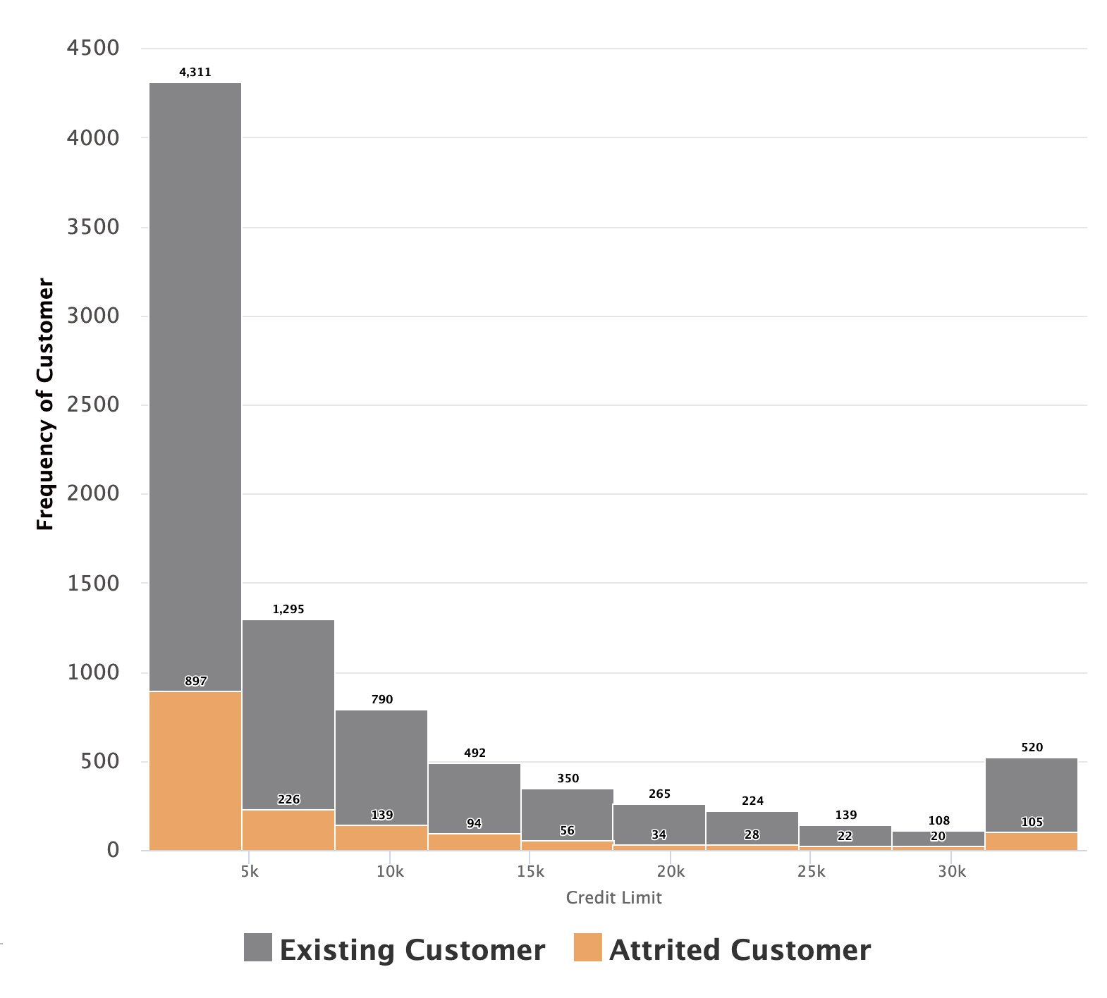
7: Credit_Limit by Sunil Kumar
 | Credit Limit | Existing Customers | Existing Customers % | Attrited Customers | Attrited Customers % | Total %
 | 0-5,000 | 4311 | 42.6% | 897 | 8.9%% | 51.5%
 | 5,000-10,000 | 2085 | 20.6% | 365 | 3.6% | 24.2%
 | 10,000-15,000 | 492 | 4.9% | 94 | 1% | 5.9%
 | 15,000-20,000 | 615 | 6% | 90 | 0.9% | 6.9%
 | 20,000-25,000 | 224 | 2.2% | 28 | 0.3% | 2.5%
 | 25,000-30,000 | 247 | 2.4% | 42 | 0.5% | 2.9%
 | 30,000-34,516 | 520 | 5.1% | 105 | 1% | 6.1%
Total Count |  | 8494 | 84% | 1621 | 16% | 100%

Slide 34
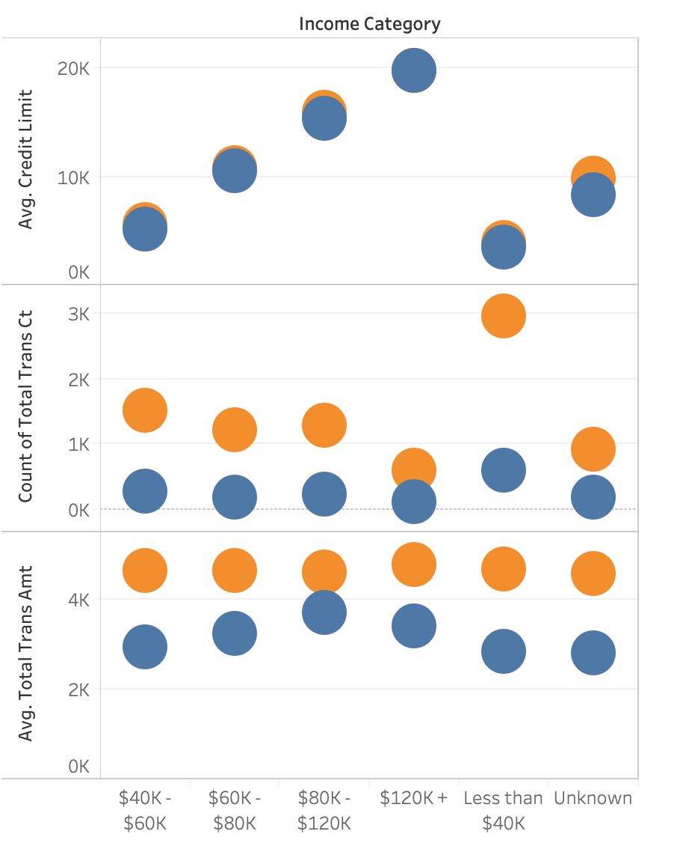
7: Credit_Limit - Assumption for Churn by Sunil Kumar
Here we have used the graph representations to assume which customers are likely to churn. Using Income Category, Avg. Credit Limit, Count of Total Trans Ct and Avg. Total Trans Amt.

Slide 35
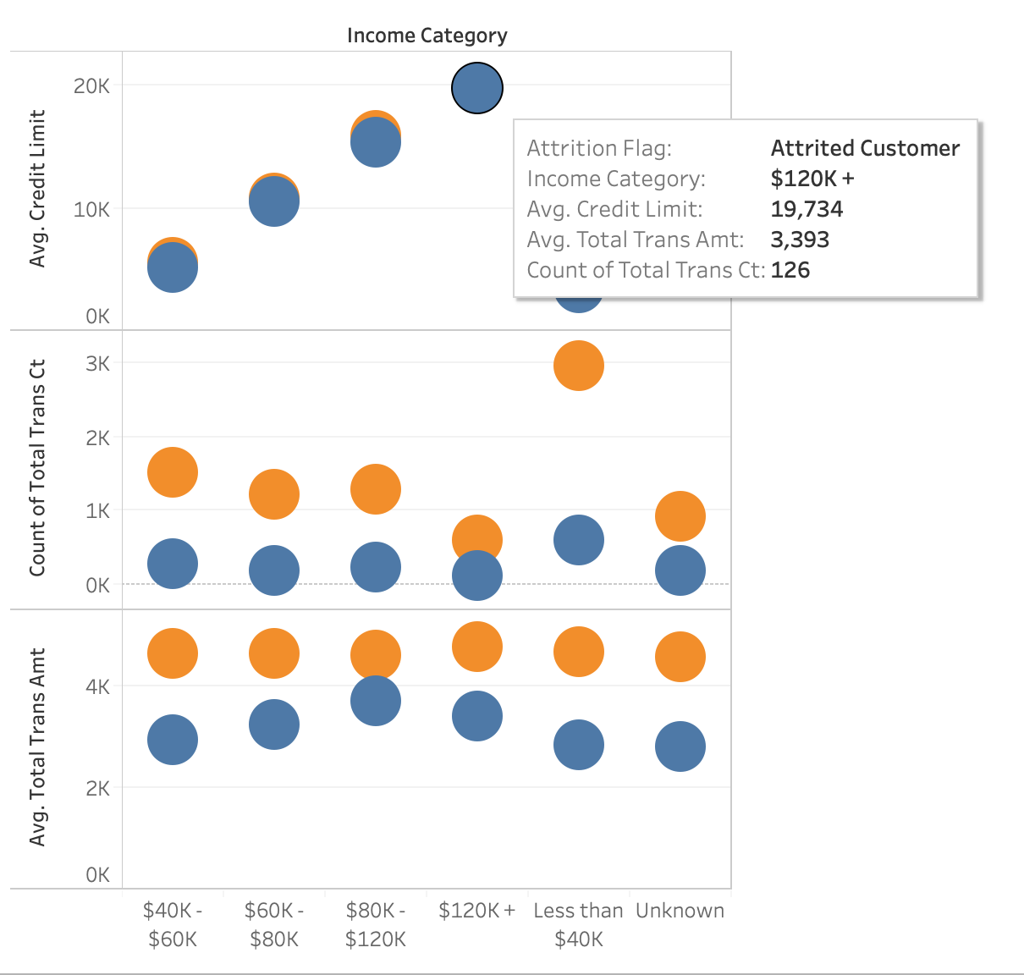
7: Credit_Limit - Assumption for Churn by Sunil Kumar
Here, You can see the Attrited Customer has high income but his/her total trans ct and total trans amt is very low, so as per our assumptions this customer is likely to churn.

Slide 36
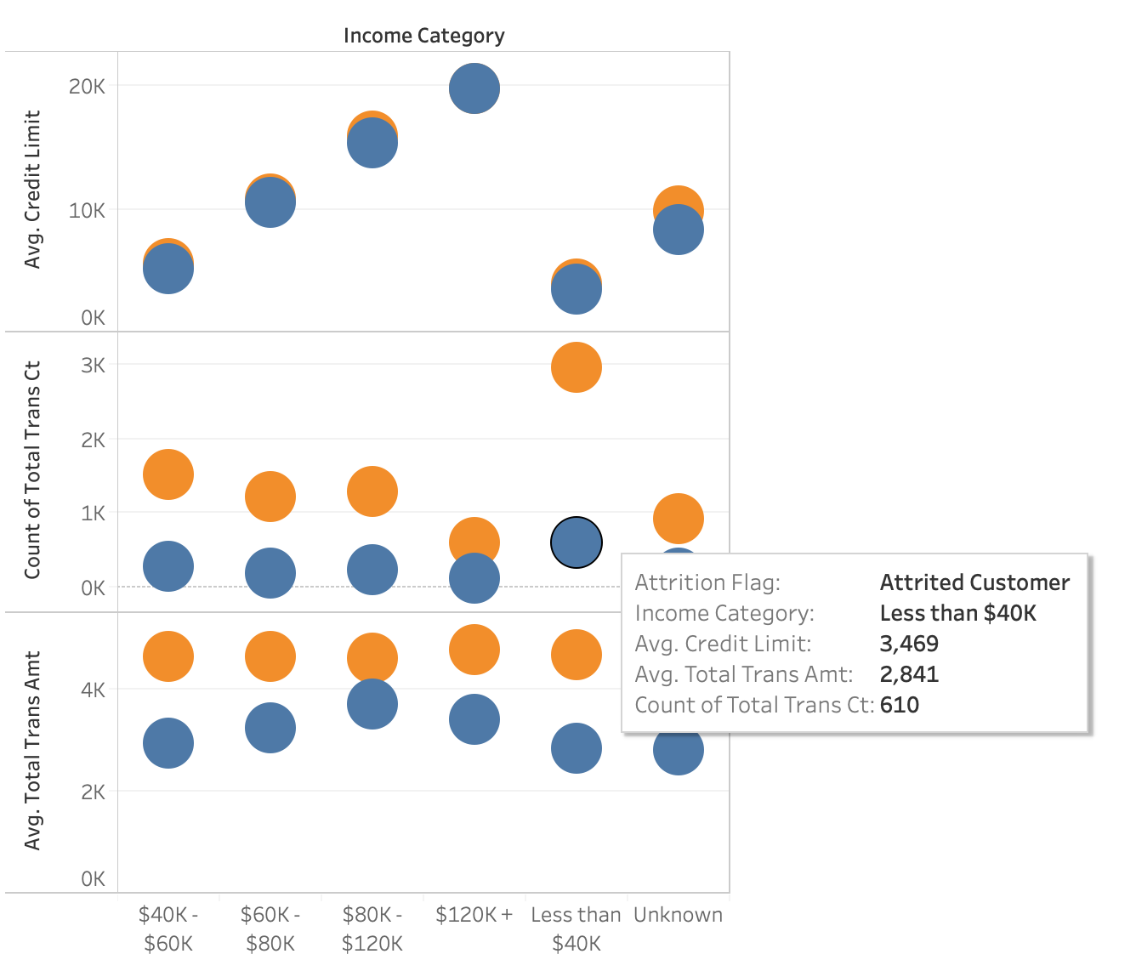
7: Credit_Limit - Assumption for Churn by Sunil Kumar
Here, You can see the Attrited Customer has low income but his/her total trans ct and total trans amt is high compared to customer who earns high, so as per our assumptions this customer is likely to stay.

Slide 37
7: Credit_Limit Summary by Sunil Kumar
Credit Limit is the total purchasing power given by bank on the Credit Card to customers.
All attrited customers have at least 1438.3 credit limit in the bank.
1.03% attrited customers have the largest credit limit of between 31,208.23 to 34,516 in the bank.
Correlations to other variables are weak except Avg Open To Buy​ which is 99.6%

Slide 38
8 : Customer Age by Akul Jain
Number of customers in their different age group
It’s a discrete numerical variable
Range 0 – 70
No missing value
Summary Statistics
Total Count | 10115
Min | 26
Max | 73
Mean | 46.325
Median | 46
Mode | 44
Std. Deviation | 8.017

Slide 39
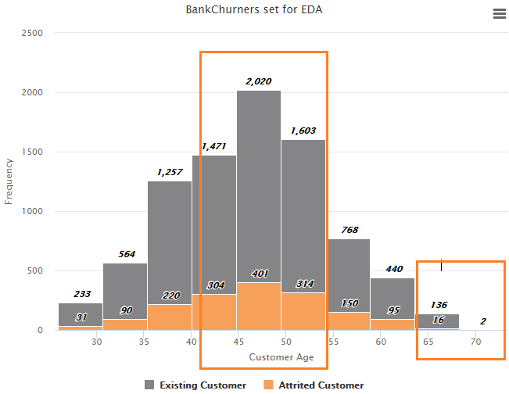
8: Customer Age by Akul Jain
Association with Target Variable
Customer Age | Existing | Attrited | Total
0 - 30 | 233 | 31 | 264
30 - 35 | 564 | 90 | 654
35-40 | 1257 | 220 | 1477
40-45 | 1471 | 304 | 1775
45-50 | 2020 | 401 | 2421
50-55 | 1603 | 314 | 1917
55-60 | 768 | 150 | 918
60-65 | 440 | 95 | 535
65-70 | 136 | 16 | 152
70+ | 2 | 0 | 2
TOTAL | 8494 | 1621 | 10115

Slide 40
8 : Customer Age by Akul Jain
Attribute 1​ | Attribute 2​ | Correlation​
Customer Age | Total Trans Ct | 0.068
 | Dependent count | 0.122
 | Months on book | 0.789
 | Total Relationship Count | 0.011
 | Months Inactive 12 mon | 0.055
 | Contacts Count 12 mon | 0.019
 | Credit Limit | 0.002
 | Total Revolving Bal | 0.019
 | Avg Open To Buy | 0.001
 | Total Amt Chng Q4 Q1 | 0.062
 | Total Trans Amt | 0.047
 | Total Ct Chng Q4 Q1 | 0.012
 | Avg Utilization Ratio | 0.007
Association with Other Variables- Correlation

Slide 41
8: Customer Age - Summary by Akul Jain
It is highly likely that if customer age is more than 70, so attrited customer percentage would be less.
The number of attrited customers are more in the age of between 45 to 50 .
The highest Correlations with the month of book variable is 0.789. The remaining all other variables are weak.
24.7% of the attrited customers are from the 45 to 50 age group. Which is highest in among all rest of the age groups.

Slide 42
Model Recommendation
We recommend following machine learning models to be used to provide a solution :
Deep Learning
Gradient Boosted Tree
Decision Tree
Logistic Regression

Slide 43
Variables Recommendation
We recommend following 9 variables to be used to build a model :
Gender
Total Relationship Count
Months Inactive 12 mon
Contacts Count 12 mon
Credit Limit
Total Revolving Bal
Total Trans Ct
Total Ct Chng Q4 Q1
Avg Utilization Ratio

Slide 44
Group Summary
87% of the attrited customers contacted the bank between 2-4 times.
All the customers contacting bank for more than 5 times attrited.
Almost 80% of attrited customers have total transaction amount lesser than 3000.
It is highly likely that the customers having lower revolving balance are more likely to be attrited.
If the customer is inactive for more then 2 months, there is a high possibility that the customer will be attrited.
Married customers are the highest in numbers for attrition, hence they had the lowest transaction count.
All attrited customers have a credit limit of at least 1438.3 in the bank.
The number of attrited customers are more for the age bracket 45 to 50.

Slide 45
2: Model Training-Testing & Comparison

Slide 46
Module 2
Team 3
Madhura Jadhav Yuri Oh Ariful Islam Sunil Kumar Akul Jain

Slide 47
Agenda
Background Summary
Training, Testing, Validation for recommended models
Gradient Boosted
Deep Learning
Decision Tree
Logistic Regression
Naïve Bayes
Model Selection
Forward Selection
Model Parameter Tuning
Conclusion

Slide 48
Background Summary
Based on EDA Phase, we recommended following 9 variables and 4 candidate models to predict customer churn
Models:
Gradient Boosted Tree
Deep Learning
Decision Tree
Logistic Regression
Variables:
Gender
Total Relationship Count
Months Inactive 12 mon
Contacts Count 12 mon
Credit Limit
Total Revolving Bal
Total Trans Ct
Total Ct Chng Q4 Q1
Avg Utilization Ratio

Slide 49
Model Design
Following is the split of the data that we have used for candidate models:
For Training and Testing,
80% of the total records = 8,092
5-Fold cross validation
For Validation,
20% of the total records = 2,023
For Performance measurement, we are focusing on following 2 metrics
Accuracy
AUC

Slide 50
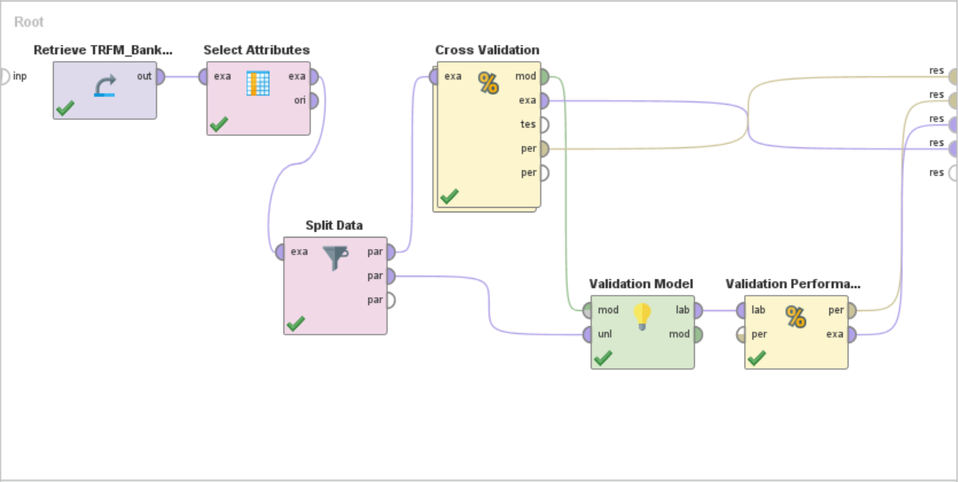
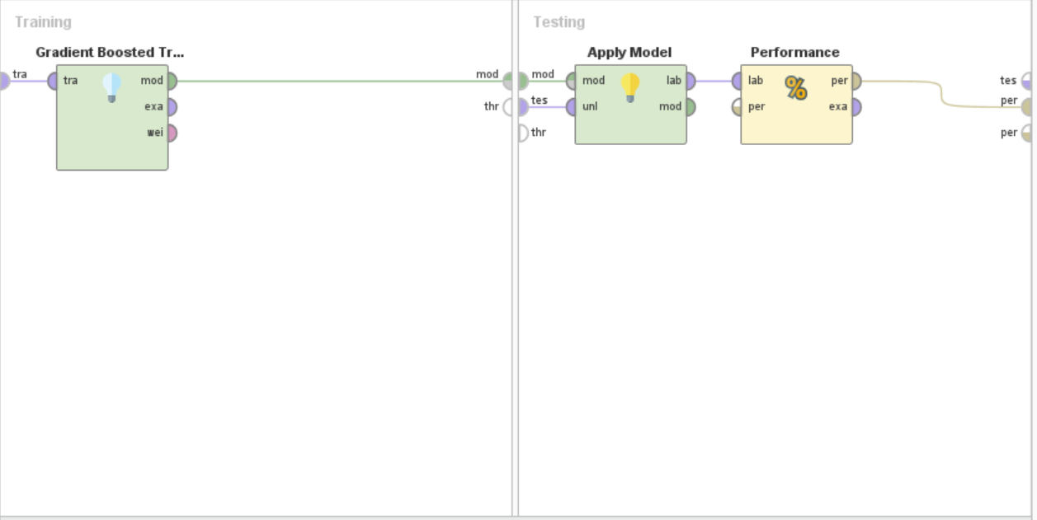
Gradient Boosted

Slide 51
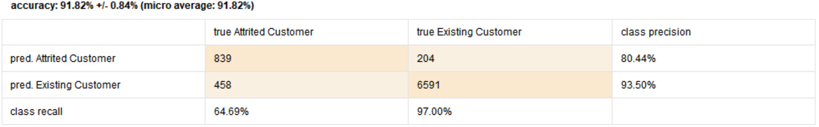
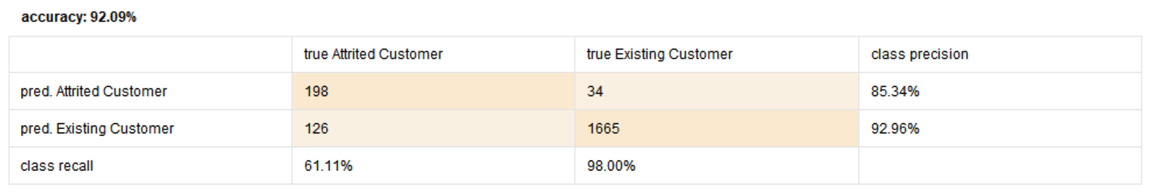
Gradient Boosted
Cross Validation (Training-Testing)
Validation

Slide 52
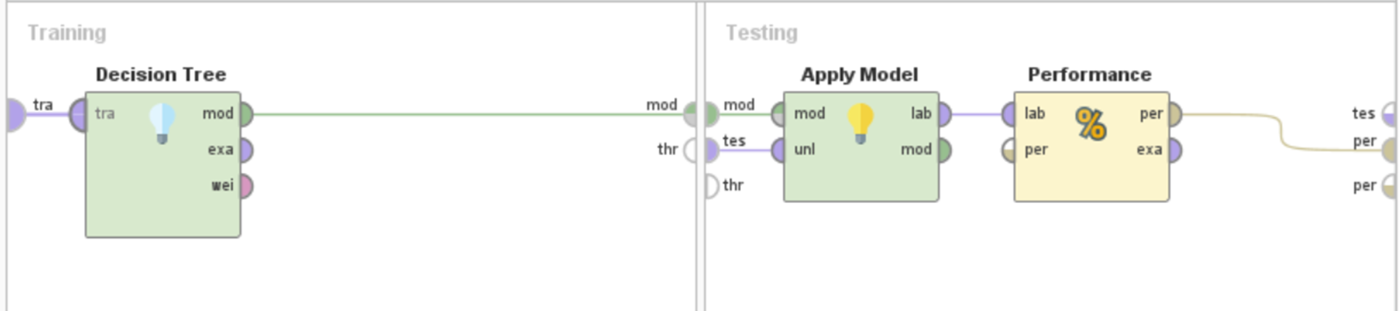
Decision Trees

Slide 53
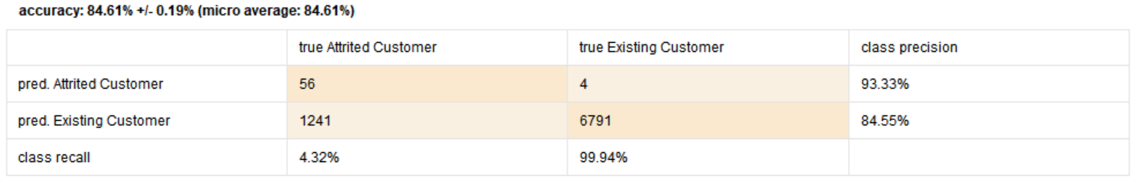
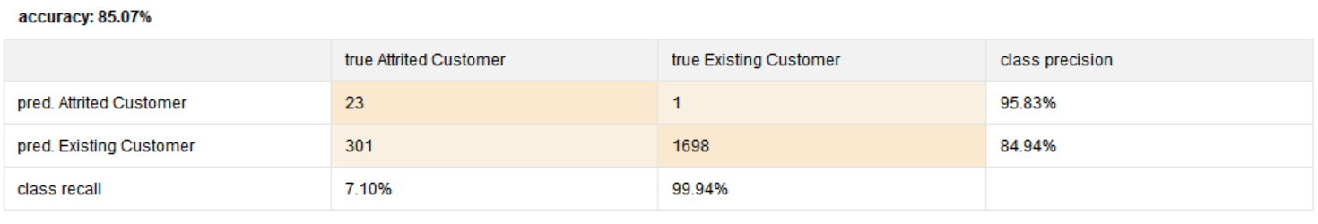
Decision Trees
Cross Validation (Training-Testing)
Validation

Slide 54
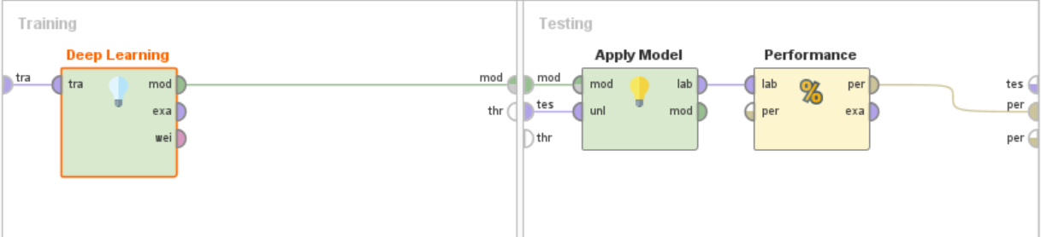
Deep Learning

Slide 55
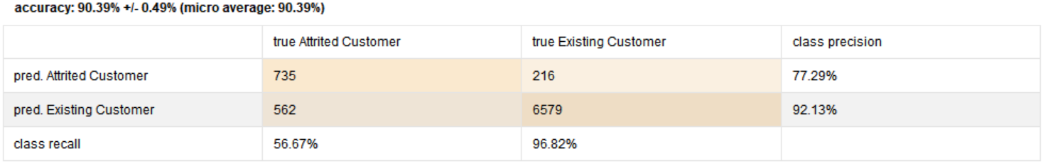
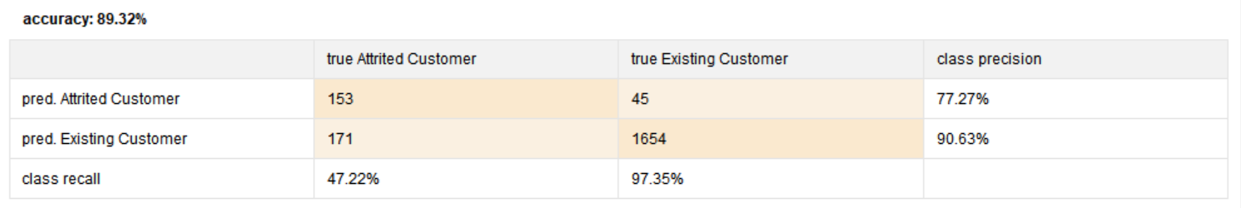
Deep Learning
Cross Validation (Training-Testing)
Validation

Slide 56
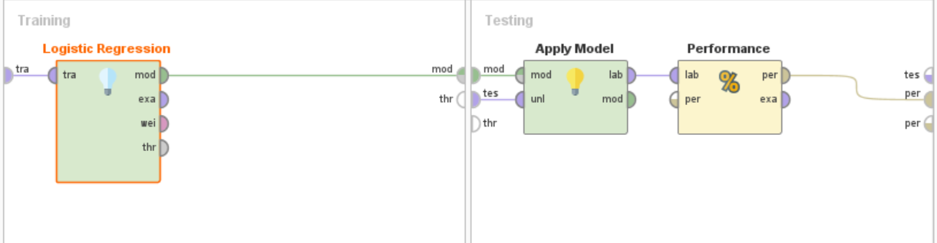
Logistic Regression

Slide 57
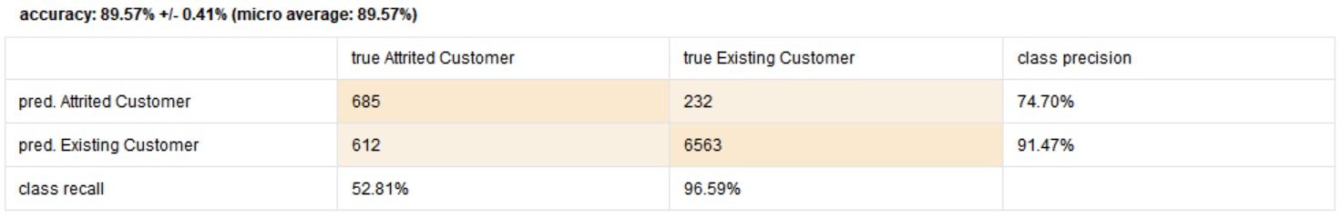
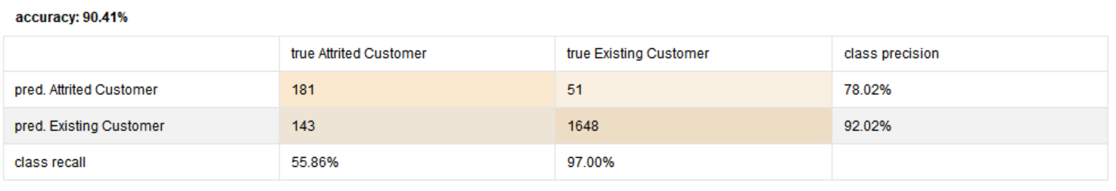
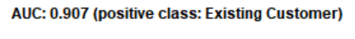
Cross Validation (Training-Testing)
Logistic Regression
Validation

Slide 58
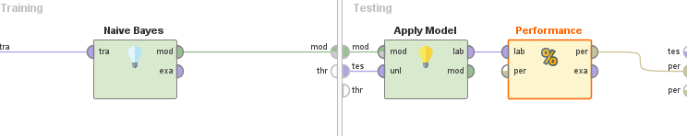
Naive Bayes

Slide 59
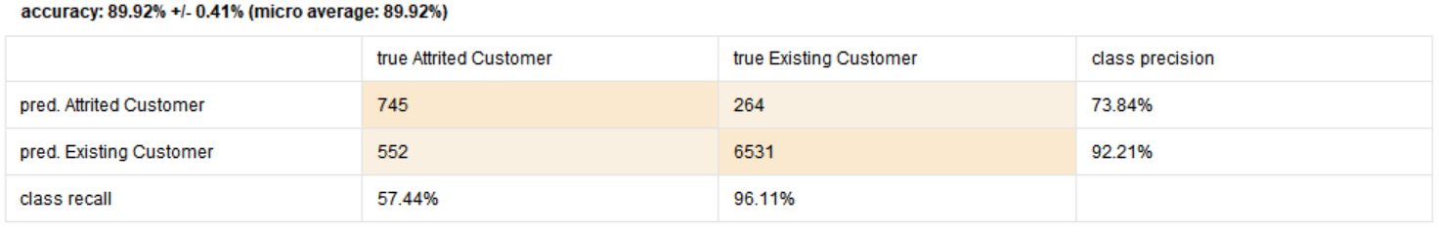
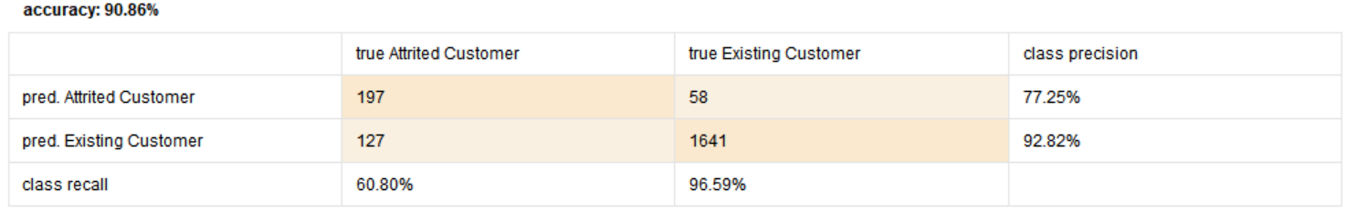
Naive Bayes
Cross Validation (Training-Testing)
Validation

Slide 60
Model Comparison
Cross Validation (Training-Testing)
Performance Metric |  | Gradient Boosting | Deep Learning | Decision Tree | Logistic Regression | Naïve Bayes
 | Accuracy | 91.82% +/-0.84% | 90.39% +/- 0.49% | 84.61% +/- 0.19% | 89.57% +/- 0.41% | 89.92% +/- 0.41%
 | AUC | 0.933 +/- 0.010 | 0.928 +/- 0.004 | 0.521 +/- 0.005 | 0.899 +/- 0.008 | 0.904 +/- 0.008
Validation
Performance Metric |  | Gradient Boosting | Deep Learning | Decision Tree | Logistic Regression | Naïve Bayes
 | Accuracy | 92.09% | 89.32% | 85.07% | 90.41% | 90.86%
 | AUC | 0.938 | 0.897 | 0.536 | 0.907 | 0.915

Slide 61
Model Selection
Based on the performance metrics, we selected Gradient Boosted as our model
Training - Testing
Accuracy: 91.82% +/-0.84%
AUC: 0.933 +/- 0.010
Validation
Accuracy: 92.09%
AUC: 0.938
To further improve this performance, we explored following techniques:
Forward Selection- to verify if the features used are best fit
Model Parameter Tuning- to see if we can improve the performance by changing parameters for the selected model

Slide 62
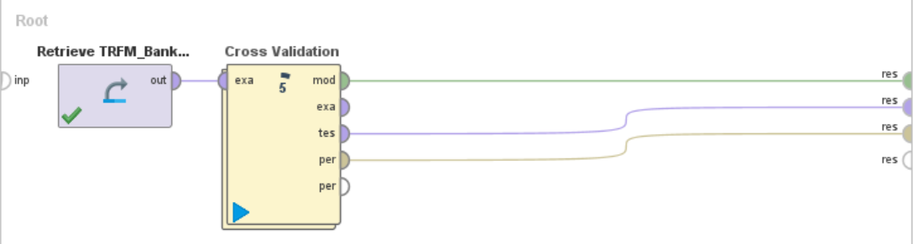
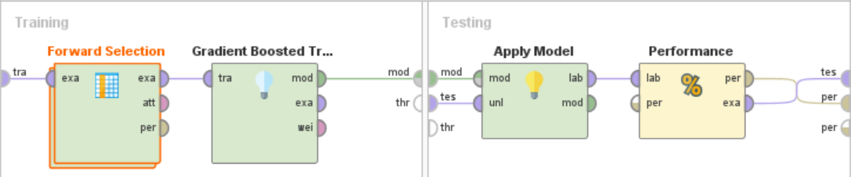
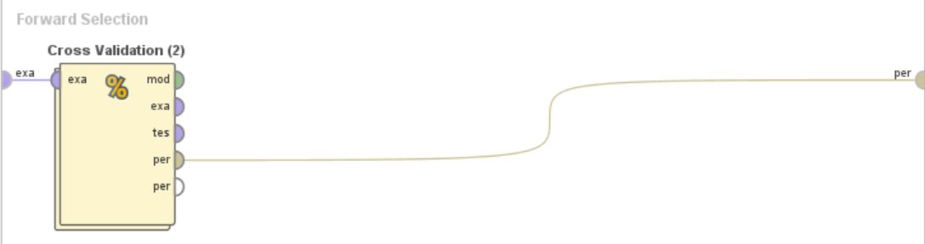
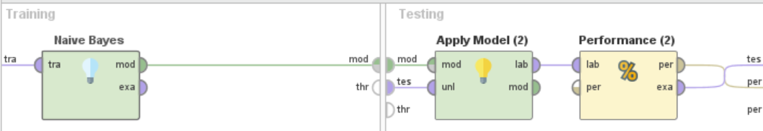
Feature Selection

Slide 63
Forward Selection Recommendation
Following are the features recommended by Forward Selection technique:
Gender
Total Relationship Count
Months Inactive 12 mon
Contacts Count 12 mon
Credit Limit
Total Revolving Bal
Total Trans Ct
Total Ct Chng Q4 Q1
Avg Utilization Ratio Customer Age
Notes:
a

Slide 64

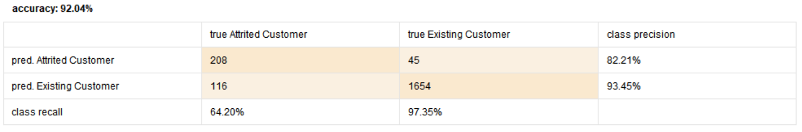
Gradient Boosted
with FS Features
Cross Validation (Training-Testing)
Validation

Slide 65
Comparison after Forward Selection
Cross Validation (Training-Testing)
Performance Metric |  | GB with EDA features | GB with Forward Selection features
 | Accuracy | 91.82% +/- 0.84% | 91.62% +/- 0.83%
 | AUC | 0.933 +/- 0.010 | 0.934 +/- 0.010
Validation
Performance Metric |  | GB with EDA features | GB with Forward Selection features
 | Accuracy | 92.09% | 92.04%
 | AUC | 0.938 | 0.938

Slide 66
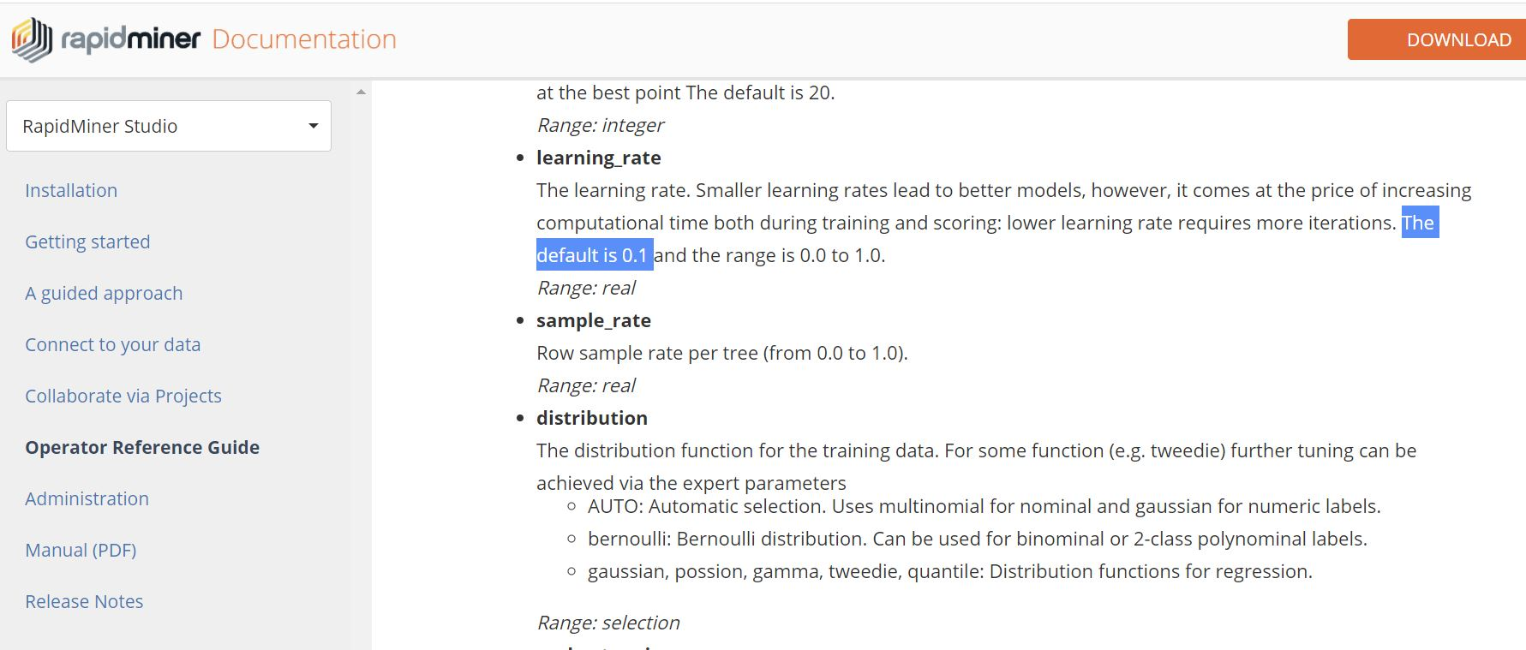
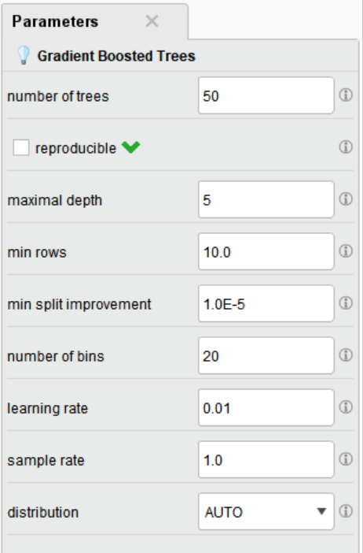

Model Parameter Tuning

Slide 67
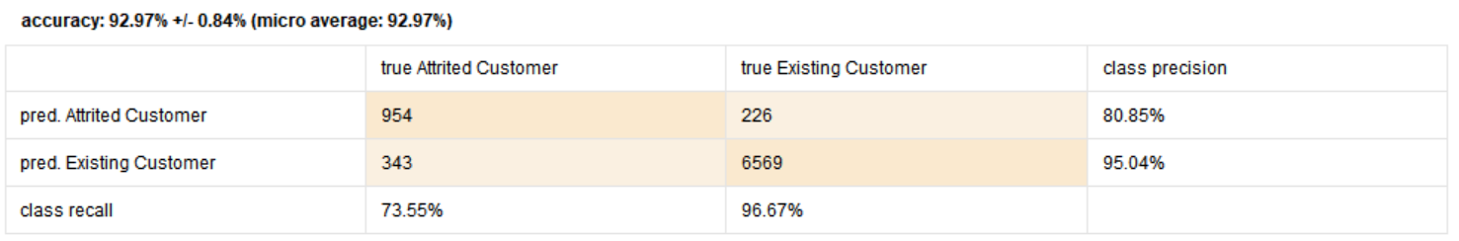
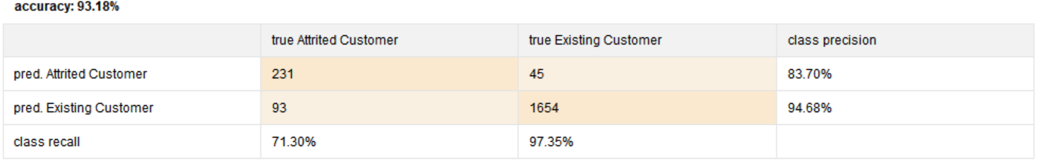
Tuned Gradient Boosted with EDA Features
Cross Validation (Training-Testing)
Validation

Slide 68
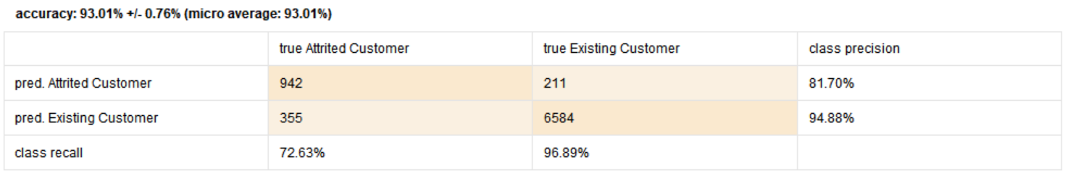
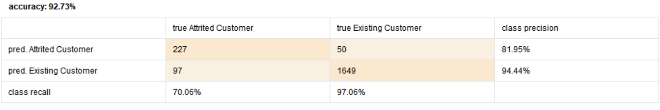
Tuned Gradient Boosted
with FS Features
Cross Validation (Training-Testing)
Validation

Slide 69
Comparison
Cross Validation (Training-Testing)
Performance Metric |  | EDA Features |  | FS Features
 |  | Non-Tuned Parameters | Tuned Parameters | Non-Tuned Parameters | Tuned Parameters
 | Accuracy | 91.82% +/- 0.84% | 92.97% +/- 0.84% | 91.62% +/- 0.83% | 93.01% +/- 0.76%
 | AUC | 0.933 +/- 0.010 | 0.958 +/- 0.008 | 0.934 +/- 0.010 | 0.960 +/- 0.007
Validation
Performance Metric |  | EDA Features |  | FS Features
 |  | Non-Tuned Parameters | Tuned Parameters | Non-Tuned Parameters | Tuned Parameters
 | Accuracy | 92.09% | 93.18% | 92.04% | 92.73%
 | AUC | 0.938 | 0.959 | 0.938 | 0.963
Notes:
GB with default parameters will have nos from slide 18

Slide 70
Conclusion
Following are the steps we took to develop best fit model to predict customer churn:
EDA – Exploration of relationship across all features (inc. predictor variables and target variable)
Training-Testing of candidate models
Apply Feature Selection Technique
Tune Model Parameter
Compare Performance Metrics i.e. Accuracy and AUC
Based on our approach the best model is Gradient Boosted with:
9 features based on Forward selection technique
Tuned “learning rate” parameter with value of 0.1
Validation Accuracy = 92.73%
Validation AUC = 0.963

Slide 71
3: Final

Slide 72
Module 3
Team 3
Madhura Jadhav Yuri Oh Ariful Islam Sunil Kumar Akul Jain
IS665: Introduction to Data Mining and Visualization

Slide 73
Agenda
Background Summary
RapidMiner Implementation
Results with old feature set
Model Retraining
Results with new feature set
Conclusion

Slide 74
Background Summary
Based on EDA, Training and Testing Phase, we have recommended Gradient Boosted Tree model with following 9 features to predict customer churn
Features:
Gender,
Total Relationship Count,
Months Inactive 12 months,
Contacts Count 12 mon,
Credit Limit,
Total Revolving Bal,
Total Trans Ct,
Total Ct Chng Q4 Q1,
Customer Age
Performance Metric |  | Gradient Boosted Tuned
 |  | Training Testing | Validation
 | Accuracy | 93.01% | 92.73%
 | AUC | 0.960 | 0.963

Slide 75
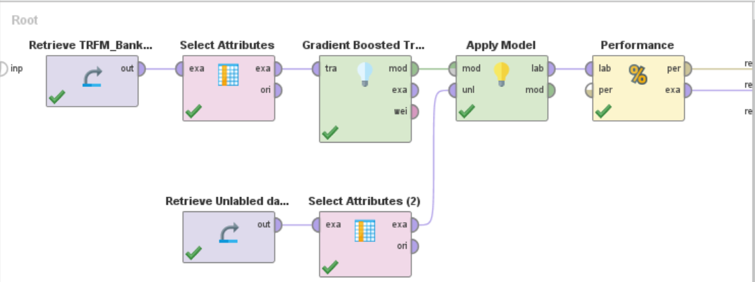
RapidMiner Implementation

Slide 76
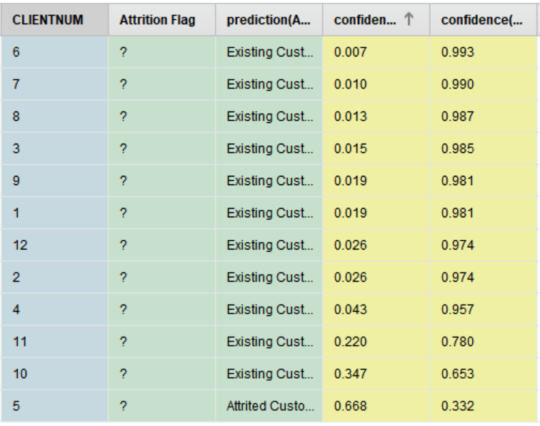
Results with revisited Feature Set
11:1 Existing Vs. Attrited proportion for the model with old feature set

Slide 77
Revisit
Model Revisit:
Revisited other 4 models: Decision Tree, Deep Learning, Logistic Regression and Naïve Bayes
Above 4 of them showed 12:0 Existing Vs. Attrited proportion for the same features
Gradient Boosted Model gave 11:1 Existing Vs. Attrited proportion
Feature Revisit (Model Retraining):
Manual application of forward selection to supplement old feature set
Recursively appended 1 feature to the existing 9 features, at a time, to observe improvements to the model performance
Addition of feature “Total Trans Amt” showcased significant improvement in the result

Slide 78
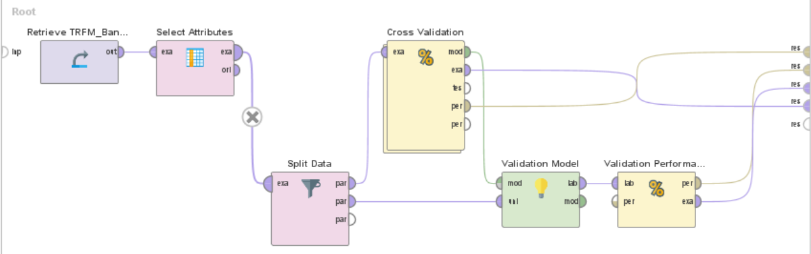
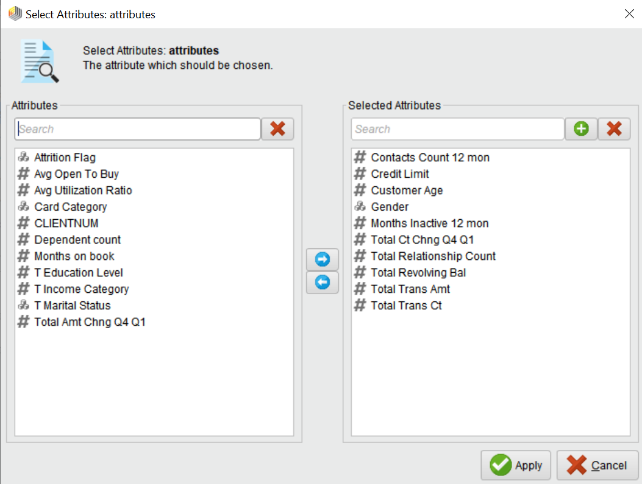
Model Retraining

Slide 79


Cross Validation (Training-Testing) Performance
Validation Performance
Performance Comparison
Performance Metric |  | 9 Features (old) |  | 10 Features (revisited)
 |  | Cross Validation (Training – Testing) | Validation | Cross Validation (Training – Testing) | Validation
 | Accuracy | 93.01% | 92.73% | 95.71% | 96.09%
 | AUC | 0.960 | 0.963 | 0.986 | 0.987

Slide 80

Results with old Feature Set
6:6 Existing Vs. Attrited proportion for the model with revisited feature set

Slide 81

Visualizations
Confidence Vs. Customer Number

Slide 82

Visualizations
Average Confidence Across Both Classes (Attrited vs. Existing)

Slide 83
Conclusion
Best model for this customer churn problem is Gradient Boosted Model with following 10 features:
Gender, Total Relationship Count, Months Inactive 12 mon, Contacts Count 12 mon, Credit Limit, Total Revolving Bal, Total Trans Ct, Total Ct Chng Q4 Q1, Customer Age, Total Trans Amt
Performance for Model Training-Testing:
Cross Validation Accuracy = 95.71%
Cross Validation AUC = 0.986
Validation Accuracy = 96.09%
Validation AUC = 0.987
Performance for Unlabeled Data:
We got 50-50 proportion with -
CLIENTNUM 1, 2, 3, 6, 7, 8 as Existing Customer
CLIENTNUM 4, 5, 9, 10, 11, 12 as Attrited Customer

Slide 84
Thank You

